Slide 1
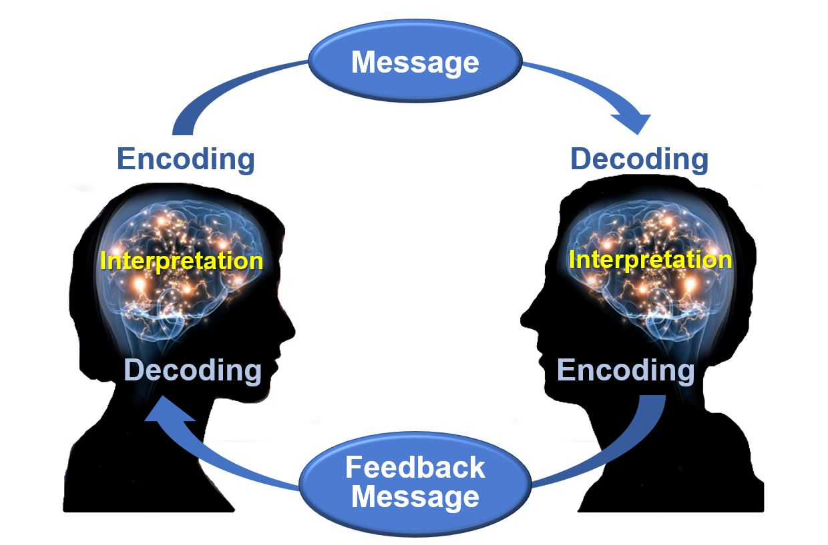
Communications Styles
Yes! They Matter
Dan Yeomans
January 2026
www.danielyeomans.org
This Photo by Unknown Author is licensed under CC BY

Slide 2
Agenda
Why Communications Styles Matter
Carl Jung: Founder of Analytical Psychology
Common Assessments
Sample Survey
The Four Quadrants

Slide 3
Why Communications Styles Matter
Fact: Projects succeed or fail largely on communication effectiveness, not technical skill.
  People receive, process, and respond to information differently.
  Misaligned communication styles are a leading cause of
    Stakeholder conflict
    Misunderstood requirements
    Reduced trust and engagement
PMI: Project leaders must tailor communications to stakeholder needs.
  Effective communication includes adapting messaging based on stakeholder preferences, culture, and context.
  Strong communicators adjust their style, rather than expecting others to adjust.
Key Takeaway: Communication styles awareness improves clarity, trust, influence, and project outcomes.

Slide 4
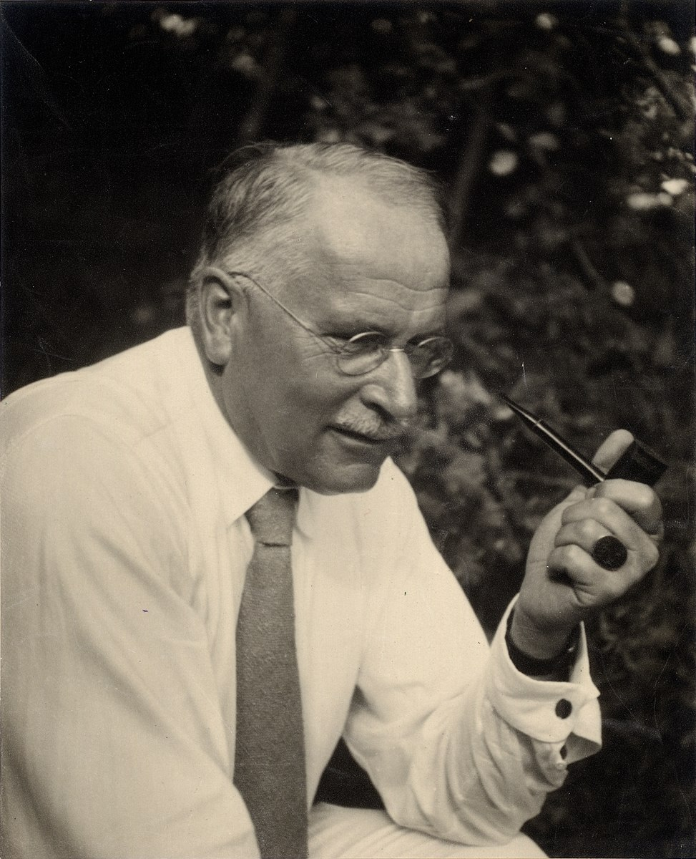
Carl Jung: Founder of Analytical Psychology
Carl Jung (1875–1961) Swiss psychiatrist and founder of analytical psychology.
Introduced the idea that people have natural psychological preferences.
His work showed that differences are normal, predictable, and measurable.
Jung’s theories became the foundation for many modern communication and personality assessments.
These insights align with our current understanding of cognitive preferences and brain information processing.

Slide 5
Common Assessment Types
Insights Discovery
  Color-based model (Red, Blue, Green, Yellow)
  Focuses on communication energy and workplace interaction
Emergenetics
  Combines thinking preferences and behavioral traits
  Emphasizes diversity of thought and team dynamics
MBTI (Myers-Briggs Type Indicator)
  Directly based on Jung’s psychological types
  Explores how people perceive information and make decisions
I-Speak
  Practical workplace communication model
  Focuses on adapting language and message delivery
DISC
  Behavioral model: Dominance, Influence, Steadiness, Conscientiousness
  Widely used for leadership, sales, and team communication
Important Note: No style is “better” than another. The value comes from recognizing differences and adapting communication accordingly.

Slide 6
The Four Quadrants
What?
Who?
How?
Why?
Vision
Big Picture
Possibilities
Relationship
Inclusion
The Team
Process
Organization
Results
Value
Data
Logic

Slide 7
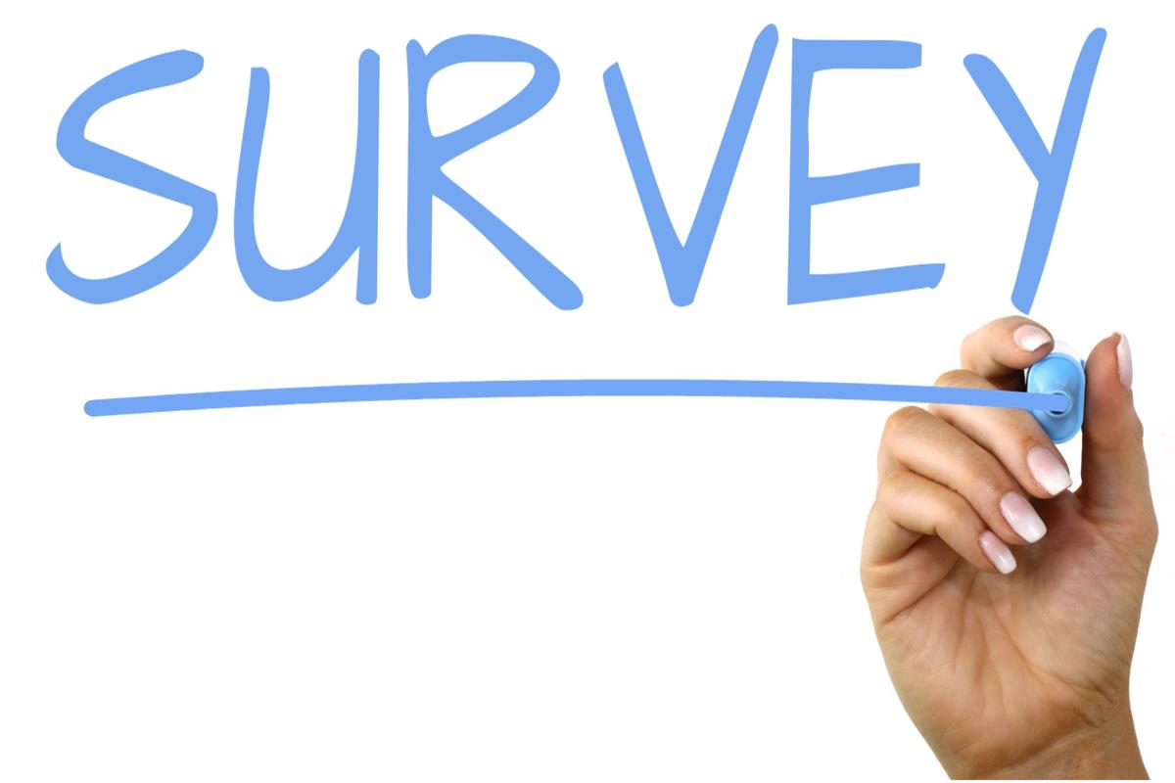
Demo Time

